Slide 1

What the Data?
Cortana Intelligence Suite
Amy Nicholson
Technical Evangelist, Microsoft
@AmyKateNicho

Slide 2
THE WORLDS DATA
Notes:
Once upon a time, all the world’s data was analog. Books, tapes, gramophone records. We had about 2.5 Exabytes of it. There was no digital.
In the 1990s that data grew. CDs came out, DVDs followed. And client-server computing. This graph shows the approximate split between different types of data.

Slide 3
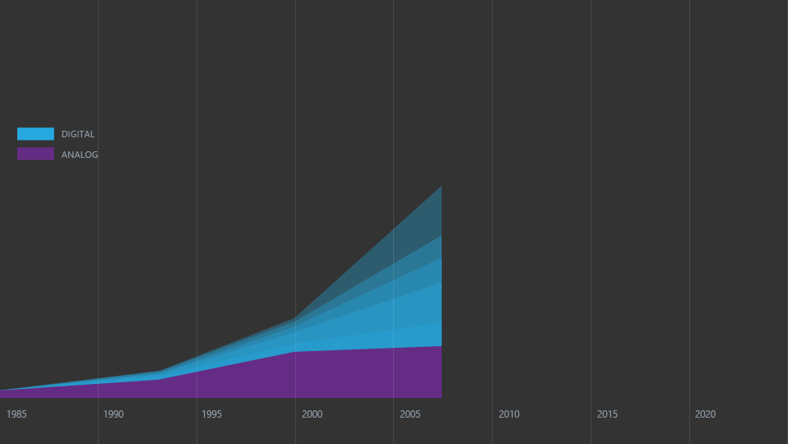
THE WORLDS DATA
DATACENTERS (CLOUD)
PC/DEVICE
DIGITAL TAPE
DVD/BLU-RAY
CD
Notes:
Then the internet came on the scene. Digital data exploded and overtook analog.

Slide 4
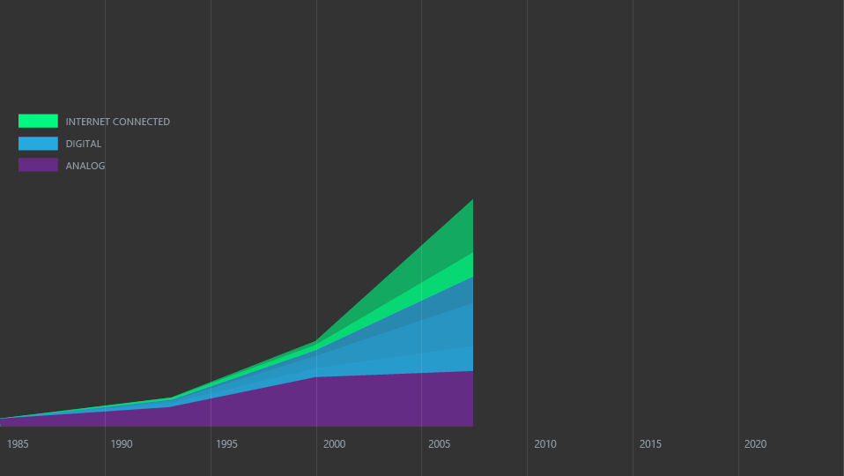
THE WORLDS DATA
DATACENTERS (CLOUD)
PC / DEVICE
DIGITAL TAPE
DVD / BLU-RAY
CD
Notes:
And the data on connected devices grew. Data now had an IP address. This is connected data.

Slide 5
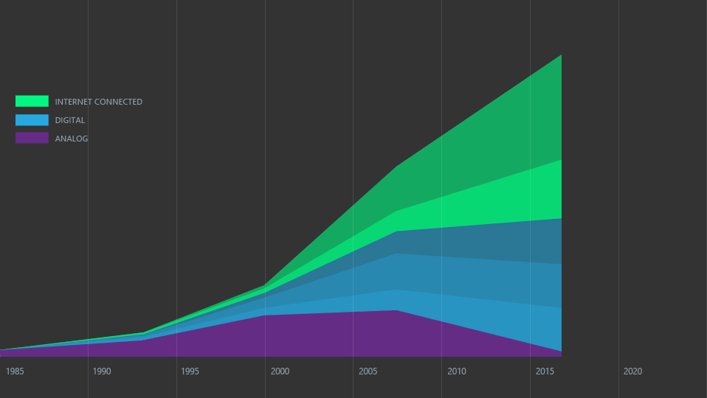
THE WORLDS DATA
CLOUD / IoT
PC / MOBILE
Notes:
The vast majority of world’s data is now digital. There are about 10 Zetabytes of it – that is about 10 million Petabytes. And connected data is taking over. And the majority of that data is on the web and in the cloud.

Slide 6
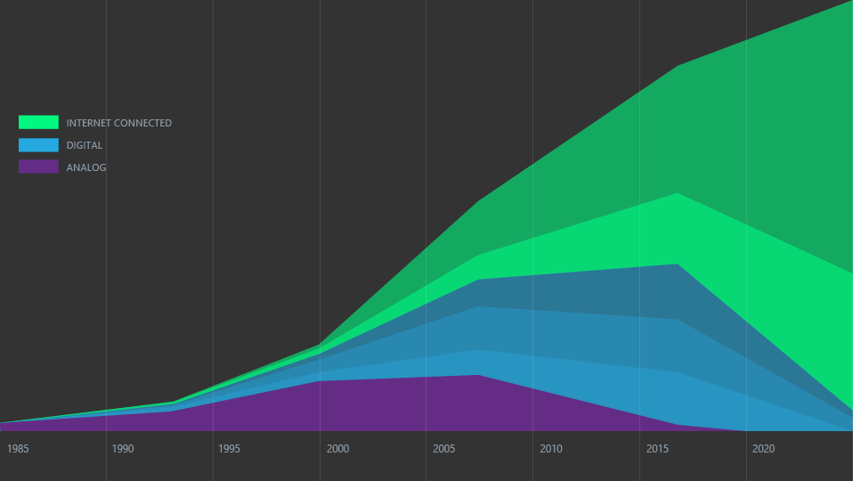
THE WORLDS DATA
CLOUD
MOBILE
Notes:
How about the future? By 2020 there will be about 50 Zetabytes of data. Data from the internet of things, from applications in the cloud, from mobile devices. The vast majority of data will be in internet connected data centers, that is, the cloud. The cloud is eating data. This is where the planet’s data, information and intelligence will reside. And this transformation is revolutionizing every industry.
Single layer Bluray holds 25GB of data – 50 Zetabytes = almost 6.5 times to the moon.

Slide 7

Fashion and retail
Notes:
Von Bismark to the Printing and Twitter dresses

Slide 8

Agriculture
EVERY COMPANY IS NOW A DATA COMPANY
Notes:
To the connected cow
https://youtu.be/oY0mxwySaSo?t=4m33s
https://www.pexels.com/photo-license/
https://www.pexels.com/photo/nature-animal-agriculture-cow-36347/

Slide 9

Science and Research
Notes:
http://news.microsoft.com/features/from-atoms-to-quarks-to-the-cosmos-internet-of-things-helps-lab-explore-the-origins-of-the-universe/#sm.0001vc2btgmeedlfyn11c9qo3dms2

Slide 10


Driven By Data

Slide 11
Reinvent productivity & business processes
INTERCONNECTED AMBITIONS
Build the intelligent cloud platform
Create more personal computing
Build the intelligent cloud platform

Slide 12
Cortana Intelligence Suite
Transform data into intelligent action

Slide 13
Transform data into intelligent action with Cortana Intelligence
Data Sources
People
Apps
Apps
Sensors & Devices
Automated systems
Cortana Intelligence
Data
Intelligence
Action
Notes:
Cortana Intelligence is Microsoft’s fully managed intelligent, big data and advanced analytics offering in the cloud, designed to help you transform your data into intelligent action.
It is a comprehensive suite that brings together technologies throughout Microsoft. It provides fast and flexible deployment, with a simple monthly subscription to reduce time and cost challenges.
Cortana Intelligence enables customers to benefit from Microsoft’s investment in the intelligent cloud and advanced analytics, spanning our leading cloud platform with easy to use tools and services that integrate with existing infrastructure and enable enterprises to extend business solutions as their needs grow over time.
With Cortana Intelligence, we are taking years of research and innovation – spanning technology & infrastructure for advanced analytics, including capabilities such as machine learning, big data storage and processing in the cloud, intelligence capabilities like vision, face and speech recognition, and integration with Cortana, Microsoft’s personal digital assistant, with the goal of helping enterprise customers make better, faster decisions to accelerate their speed of business.

Slide 14
Here are some examples of how our customers are staying ahead
Improving visibility and making accurate predictions
Getting the right products to the right places
Offering customers exactly what they want, when they want it
Fixing problems proactively before they start
Exploring new business opportunities
Remote monitoring
Demand forecasting
Risk and compliance management
Inventory management
Supply chain optimization
Marketing mix optimization
Personalized offers
Product recommendations
New product introduction
Predictive maintenance
Operational efficiency
Customer service improvement
Cross-sell and upsell
Product-as- a-service
New data- driven services
Notes:
Getting ahead by leveraging Big Data, the cloud and intelligence can take a number of forms.
It starts with understanding the data your organization has and what it can be used for.
There are several core business scenarios where our customers are finding great success with Microsoft technologies. These can be a useful starting point as you consider how your organization could benefit.
Here are a few examples of what our customers are doing to stay ahead:
They are gaining better visibility into their businesses and making better predictions
In manufacturing, this can involve using remote monitoring to know exactly what’s going on with equipment at customer sites or in remote locations
In retail, this involves optimizing demand forecasting to better predict what customer demand will look like next season, or next year.
In financial services or other areas where risk-mitigation is needed, it might involve pinpointing signs of fraud more effectively
They are using advanced analytics to ensure materials, parts and products are optimally distributed to the right places at the right times
In manufacturing, this may involve optimizing the supply chain, making sure parts are on hand in the right warehouses and at the right suppliers given historical patterns
In retail, this involves more precisely managing inventory and ensuring it goes to the right place the first time, which preserves margins by reducing the need to ship inventory elsewhere. If a customer looks at a product online, then comes into a store to purchase it, the retailer can have advance warning and be prepared with the item in stock (or know where it is in a nearby store)
These are both examples of better optimizing the marketing mix – using advanced analytics and intelligence to ensure the right product is in the right place, at the right price
Across industries, getting the right items to the right places contributes to operational efficiency objectives
Offering customers what they want, when they want it, using advanced analytics to develop deep, 360-degree view of customers and deliver personalized experiences
In manufacturing, this may involve tracking a customer’s use of a particular product, identifying wear patterns, offering advice on how to make the product last longer, and offering targeted promotions on replacement parts. This enables manufacturers to anticipate what customers need before they even ask.
In retail, this can involve tracking every customer interaction and purchase, whether in-store, online, via social media, via a mobile app or other channels. Assembling a picture of the customer in this way helps retailers better predict what customers are looking for, and can offer targeted promotions and offers.
In financial services, this might involve making more tailored product recommendations based on customer information from across channels - from detailed demographics to social media interactions.
Across industries, using data, advanced analytics and intelligence capabilities can support more successful new product introduction. With these technologies, you can reduce the likelihood of introducing products that flop by informing product development with data and analytics.
Fixing problems proactively, before products and equipment ever break down
Across many industries, this can involve starting predictive maintenance programs – whether that’s for your own equipment, assets or facilities, or for products installed at customer sites
Across many industries, getting problems proactively handled can support operational efficiency gains – it’s usually cheaper, faster and easier to prevent a problem than to fix it after the fact. Whether you’re talking about chronic disease care or expensive equipment at a manufacturing site, the principle is the same.
Across many industries, customer service improvement as a result of advanced analytics and big data is an example of fixing problems proactively before they start. For example, if you’re a cable provider, and you know there have been service quality problems for a certain customer, you can proactively, automatically offer them a discount, and notify them that you are working on the problem, and offer a target resolution time. This could prevent them from calling into your call center multiple times, and may even prevent them from switching to another firm.
Building data-driven service offerings, such as delivering products-as-services or packaging data for commercial sale
In any industry offering physical products, this might involve offering products as services. Instead of a single transaction where a product is exchanged, the product is automatically serviced and updated, maintaining the relationship with the customer and creating opportunities for cross-sell and upsell.
In manufacturing, using advanced analytics and big data to identify typical wear patterns and next-logical-purchases, firms can offer targeted promotions on replacement parts as well as complementary products
These are just a few of the many examples out there. Other examples include real-time recommendations, better customer acquisition, optimized loyalty programs and lifetime customer value, customer churn forecasting, fraud detection, pay for performance, more accurate product segmentation, better pricing strategies and many more.
<Transition>: Let’s take a look at one example.

Slide 15
Cortana Intelligence: Data to Intelligent Action
Information Management
Big Data Stores
Machine Learning and Analytics
Intelligence
Data Sources
People
Data Factory
Data Lake Store
Machine Learning
Cognitive Services
Data Catalog
SQL Data
Warehouse
Data Lake Analytics
Bot Framework
Web
Apps
HDInsight
(Hadoop and Spark)
Event Hubs
Cortana
Mobile
Apps
Stream Analytics
Bots
Dashboards & Visualizations
Sensors and devices
Power BI
Automated Systems
Data
Intelligence
Action
Notes:
Cortana Intelligence delivers an end-to-end platform with an integrated and comprehensive set of tools and services to help you build intelligent applications that let you easily take advantage of Advanced Analytics and intelligence capabilities.
First, Cortana Intelligence provides services to bring data in, so that you can analyze it. It provides information management capabilities like Azure Data Factory so that you can pull data from any source (relational DB like SQL or non-relational ones like your Hadoop cluster) in an automated and scheduled way, while performing the necessary data transforms (like setting certain data columns as dates vs. currency etc). Think ETL (Extract, Transform, Load) in the cloud. Event Hubs does the same for IoT type ingestion of data that streams in from lots of end points.
The data brought in then can be persisted in flexible big data storage services like Data Lake Store and Azure SQL Data Warehouse.
You can then use a wide range of analytics services from Machine Learning to Azure Data Lake Analytics to Azure HDInsight to Azure Stream Analytics to analyze the data stored in the big data storage. This means you can create analytics services and models specific to your business need (say real time demand forecasting).
The resultant analytics services and models created by taking these steps can then be surfaced as interactive dashboards and visualizations via Power BI.
These same analytics services and models created can also be integrated into various different UI (web apps or mobile apps or rich client apps), or with Cortana, so end users can naturally interact with them via speech etc., and so that end users can get proactively be notified by Cortana if the analytics model finds a new anomaly (unusual growth in certain product purchases- in the case of real time demand forecasting example given above) or whatever deserves the attention of the business users. Similar integration can occur with Cognitive Services or Bot Framework based applications.
At a high level though, Cortana Intelligence capabilities are in three main areas: data, analytics and intelligence.

Slide 16
Cortana Intelligence: Data to Intelligent Action
Information Management
Big Data Stores
Machine Learning and Analytics
Intelligence
Data Sources
People
Data Factory
Data Lake Store
Machine Learning
Cognitive Services
Data Catalog
SQL Data
Warehouse
Data Lake Analytics
Bot Framework
Web
Apps
HDInsight
(Hadoop and Spark)
Event Hubs
Cortana
Mobile
Apps
Stream Analytics
Bots
Dashboards & Visualizations
Sensors and devices
Power BI
Automated Systems
Data
Intelligence
Action
Notes:
Cortana Intelligence delivers an end-to-end platform with an integrated and comprehensive set of tools and services to help you build intelligent applications that let you easily take advantage of Advanced Analytics and intelligence capabilities.
First, Cortana Intelligence provides services to bring data in, so that you can analyze it. It provides information management capabilities like Azure Data Factory so that you can pull data from any source (relational DB like SQL or non-relational ones like your Hadoop cluster) in an automated and scheduled way, while performing the necessary data transforms (like setting certain data columns as dates vs. currency etc). Think ETL (Extract, Transform, Load) in the cloud. Event Hubs does the same for IoT type ingestion of data that streams in from lots of end points.
The data brought in then can be persisted in flexible big data storage services like Data Lake Store and Azure SQL Data Warehouse.
You can then use a wide range of analytics services from Machine Learning to Azure Data Lake Analytics to Azure HDInsight to Azure Stream Analytics to analyze the data stored in the big data storage. This means you can create analytics services and models specific to your business need (say real time demand forecasting).
The resultant analytics services and models created by taking these steps can then be surfaced as interactive dashboards and visualizations via Power BI.
These same analytics services and models created can also be integrated into various different UI (web apps or mobile apps or rich client apps), or with Cortana, so end users can naturally interact with them via speech etc., and so that end users can get proactively be notified by Cortana if the analytics model finds a new anomaly (unusual growth in certain product purchases- in the case of real time demand forecasting example given above) or whatever deserves the attention of the business users. Similar integration can occur with Cognitive Services or Bot Framework based applications.
At a high level though, Cortana Intelligence capabilities are in three main areas: data, analytics and intelligence.

Slide 17









2015
Intelligence
2012
Big Data
2008
Cloud

Slide 18





Part of
Σ
Cognitive Services
Azure
Machine Learning
Data Science
Languages
Computational
Network Toolkit
Data Science Expertise
Vision
Intelligence
Text
Intelligence
Speech
drive
enhance
Depends on
Big Data
Knowledge
Process
Visualisation
Search
drive
Cloud
Us
conversation

Slide 19

FOCUS on DIFFERENTIATION

Slide 20
Key takeaways
Read more on Cortana Intelligence: http://aka.ms/cortanaintelligencelink
Browse the Gallery to see what others are building: https://gallery.cortanaintelligence.com/browse
Gain all the resources from the session: https://github.com/dxuk/AzureWorkshops
Amy Nicholson
Technical Evangelist, Microsoft
@AmyKateNicho

